Slide 1
Welcome

Slide 2
Synopsis:
Adobe Photoshop
Illustrator

Slide 3

ADOBE
PHOTOSHOP

Slide 4


PHOTOSHOP
Posters

Slide 5


PHOTOSHOP
Advertisements

Slide 6

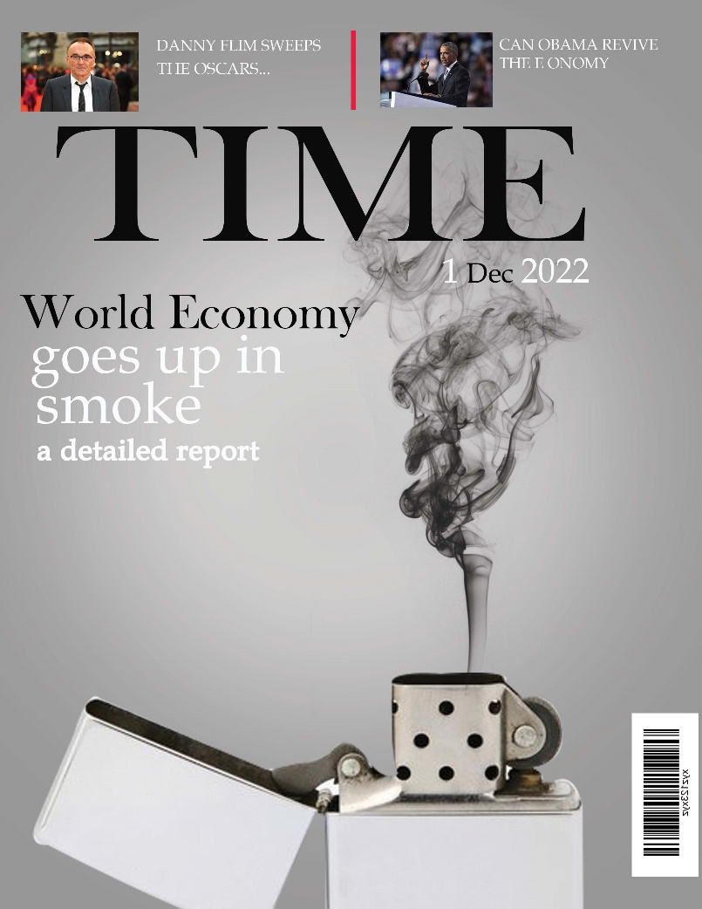
PHOTOSHOP
Magazine Cover Page

Slide 7

PHOTOSHOP
Social media Banner

Slide 8

ILLUSTRATOR

Slide 9

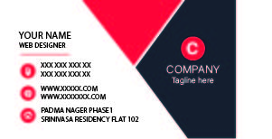
ILLUSTRATOR
Stationary Design
Visiting card :
Front part
Back part

Slide 10
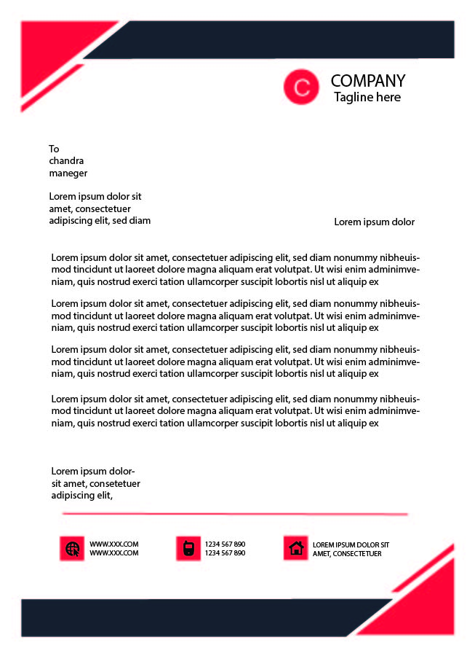
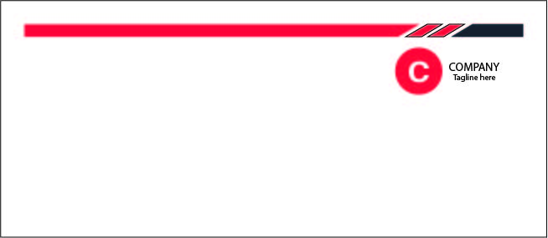
ILLUSTRATOR
Stationary Design
Letter Head
Envelope

Slide 11
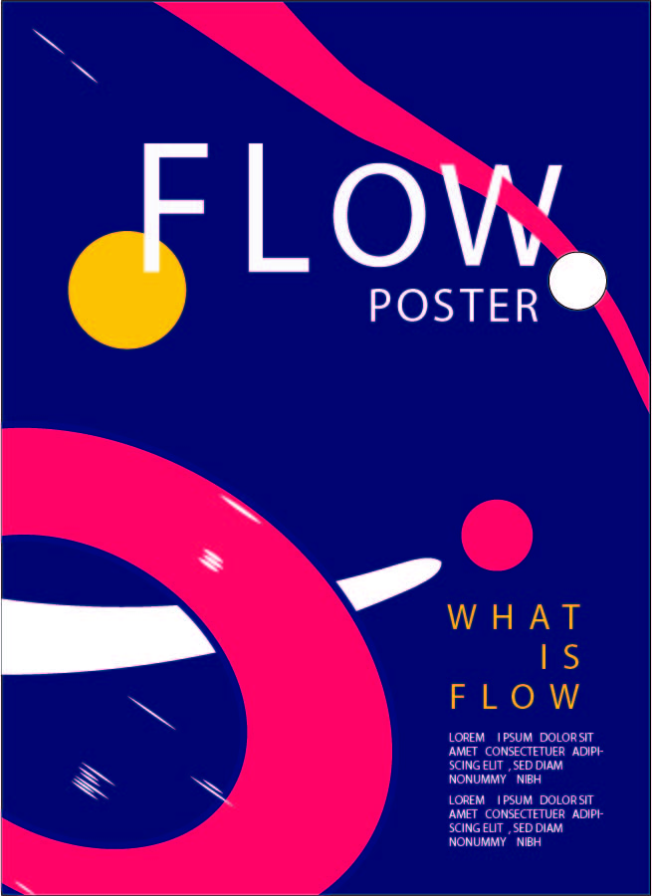
ILLUSTRATOR
Vector poster

Slide 12
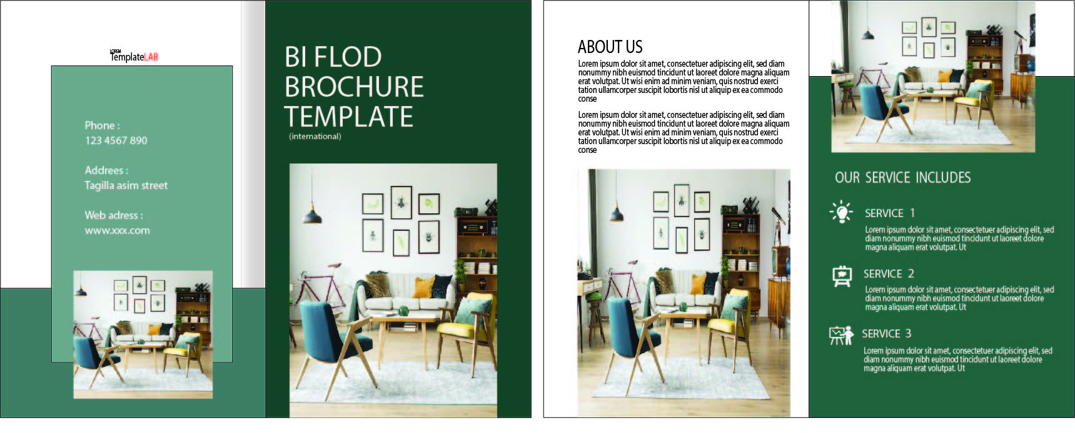
ILLUSTRATOR
Brochure

Slide 13
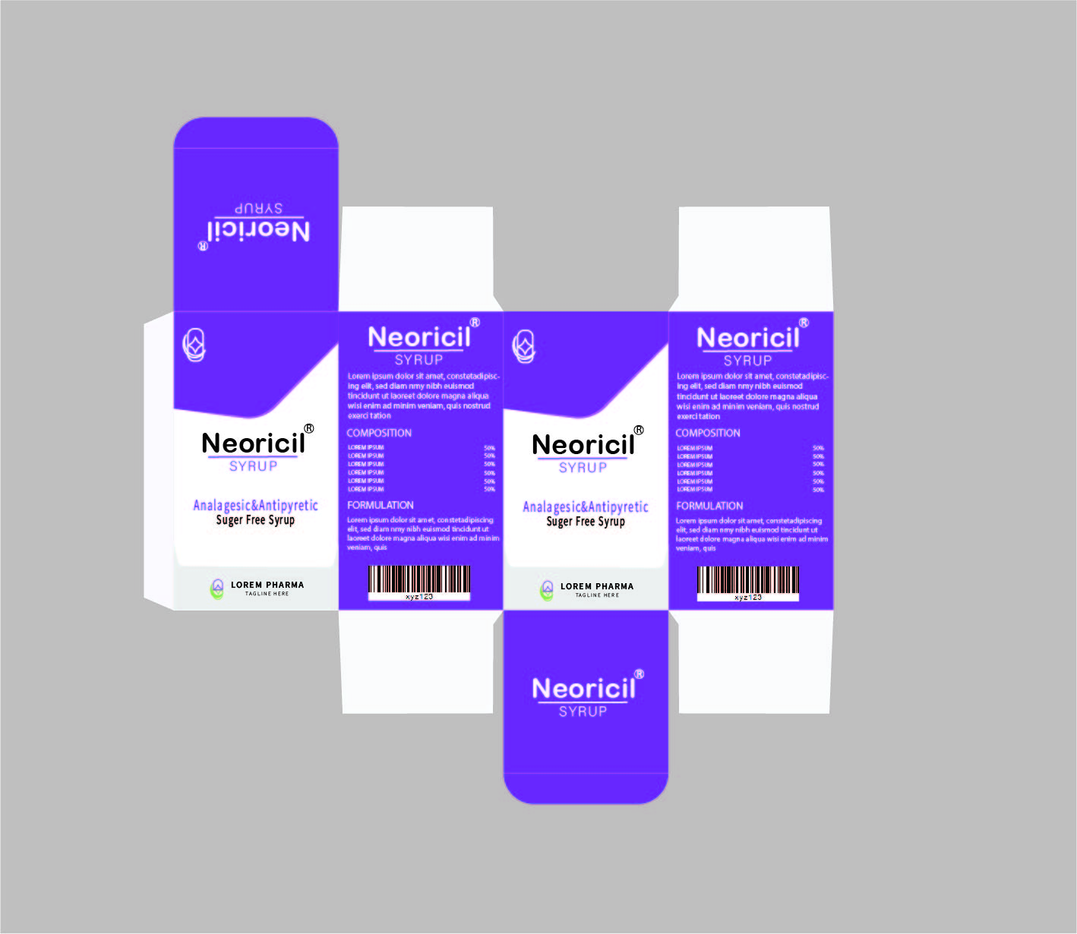
ILLUSTRATOR
package

Slide 14
Thank you

